Slide 1


DATA
SCIENCE
5th DEC 2024

Slide 2
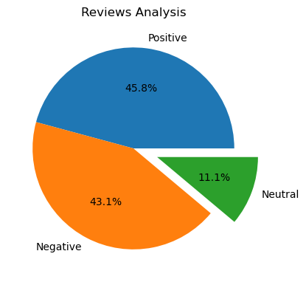
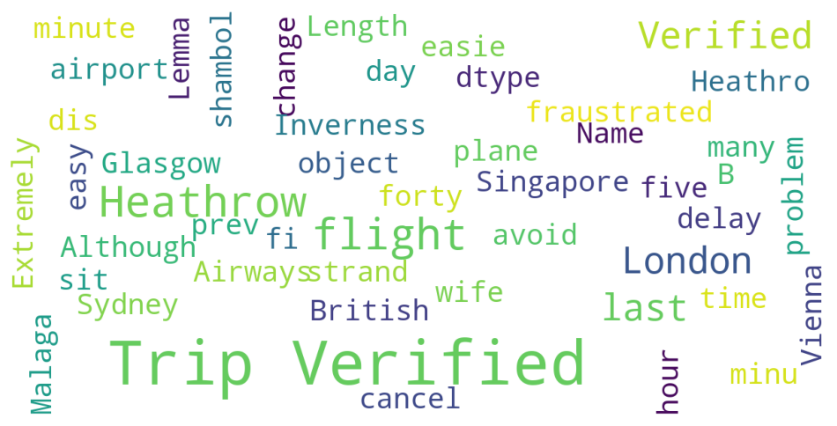
INSIGHTS FROM CUSTOMER REVIEWS
From 1000 reviews given by customer ,we concluded:
Positive reviews:538
Negative reviews:347
Neutral reviews:115

